Slide 1

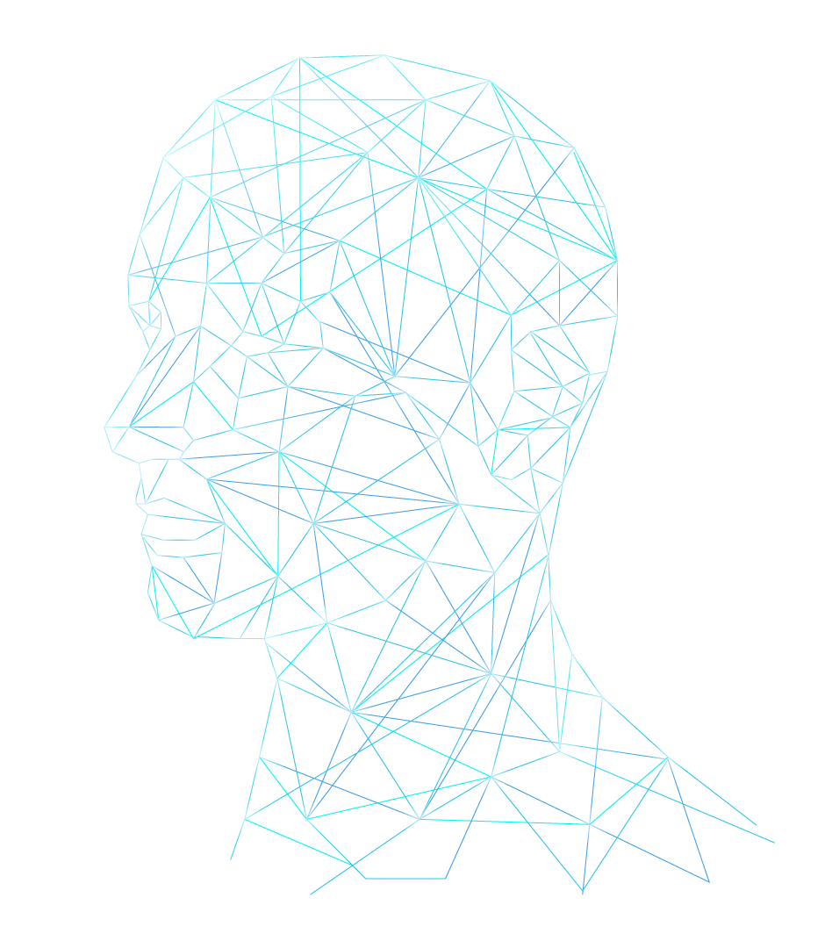
Digitalized Diagnostic in Health Care
Domain – AI in Healthcare
Made By Team– Vision AI

Slide 2
Team Members
Durga C Team Leader (3rd Year B.Sc IT)
Mail id - durgac92006@gmail.com
Lalitha Priyadarshini J (3rd Year B.Sc IT)
Mail id - lalithapriyadarshini05@gmail.com
Baranika D (1st Year B.Sc IT)
Mail id – baranikabara10@gmail.com
KaarticKarrupia M (1st Year B.Sc IT)
Mail id – kaartickaartic10@gmail.com

Slide 3

Problem Statement
Problems faced in The Healthcare Industry:
accuracy of diagnosis
clinical workflows bottleneck
And other areas of healthcare such as
disease detection
patient monitoring,
medical imaging analysis
personalized medicine

Slide 4
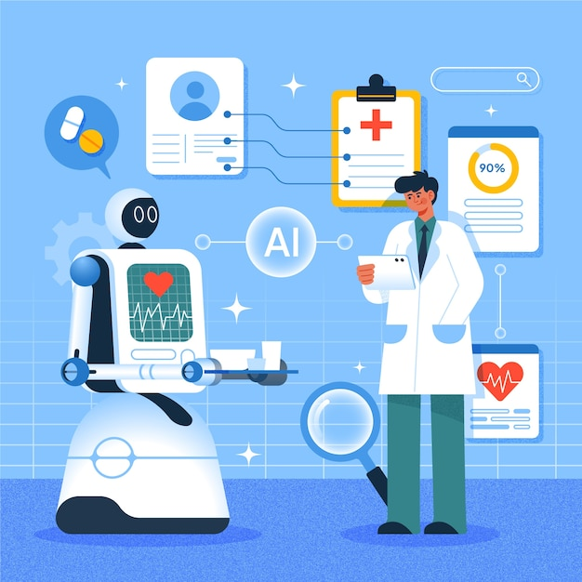
Solution
Our Goals are to Improve:
Improve diagnosis accuracy
Enhance patient outcomes
Streamline clinical workflows
Reduce healthcare costs

Slide 5
Technical Details
Data Collection & Preprocessing
We plan on Utilizing publicly available medical datasets, and normalized, selected key features to enhance model performance
Model Development
We plan on Implementing suitable machine learning models (e.g., Decision Trees, CNNs) using Python libraries like Scikit-learn, TensorFlow. Optimized using cross-validation
Prototype Deployment
We plan on Building an interactive interface (Streamlit/Flask) to simulate real-time predictions and user interaction.
Ethical Compliance
We Ensure data privacy, minimized bias, and maintained transparency in model decisions.

Slide 6
Development Process
Requirement Gathering:
We plan on developing project through detailed analysis and stakeholder input
Design and Prototyping:
We also idealize on Create wireframes, mockups, and prototypes to visualize the solution and gather feedback
Implementation and Testing:
Develop the solution based on the design specifications, followed by extensive testing and quality assurance.

Slide 7
Results
We Promise to Deliver:
A functional prototype or proof-of-concept
A clear explanation of the problem being addressed and the solution
Demonstration of the AI-powered solution's effectiveness

Slide 8
Thank You

